Slide 1
Volunteer Guru
Team 4:
Charly Garcia, Carlos Perez, Romanov Andre, Paul Nicowski, David Ensign

Slide 2
GROUP MEMBERS/ROLES
Charly Garcia (Team Leader / Flex Programmer)
Organizes meetings and ensures deadlines are being met.
Help front/back end programming when necessary.
Carlos Perez (Front-End Programmer)
Responsible for the GUI and visual design of the program.
Romanov Andre (Back-End Programmer)
Responsible for majority of back-end programming and functions.
Paul Nicowski (Back-End Programmer)
Responsible for majority of back-end programming and functions.
David Ensign (Documenter / Flex Programmer)
Responsible for all documentation and organization of the project.
Help front/back end programming when necessary.
*All members are responsible for the functionality of the finished product.

Slide 3
SUMMARY
We are creating a Volunteer/Organization matching program
Allow volunteers to search for charity organizations
Allow a charity organization to search and recruit volunteers for events
Volunteers can find organizations that match their interests based on location

Slide 4
FUNCTIONALITY
Volunteers and organizations can create and edit a profile.
Volunteers can search for an organization
Organizations can search for volunteers
Organizations can create charity events that volunteers can join or be invited
Volunteers can join charity events
Volunteers can follow organizations for further news/updates from organization

Slide 5
SCHEDULE/PLAN
Artifact | Due Dates
Meeting Minutes | **Keep track all semester**
Project Plan (document) | 10/11/2018
SRS (document) | 10/12/2018
Prototype | 10/20/2018
Presentation 1 | 10/25/2018
Design | 11/02/2018
User's Manual (document) | 11/26/2018
Test Results | 11/30/2018
Source, Executable, Build Instructions | 11/30/2018
Presentation 2 | 12/05/2018
Mandatory Group Meetings:
Every Wednesday
5:45 - 6:45PM

Slide 6
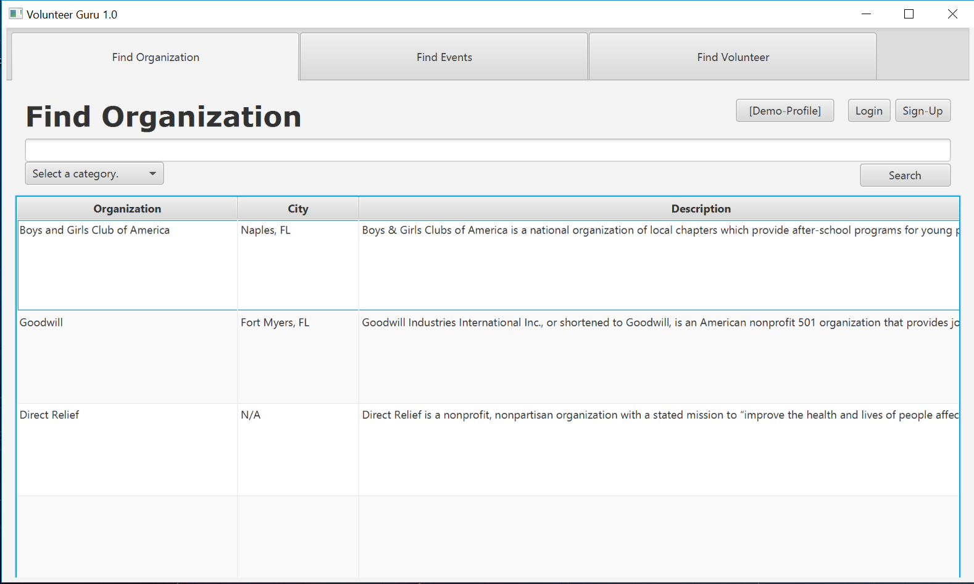
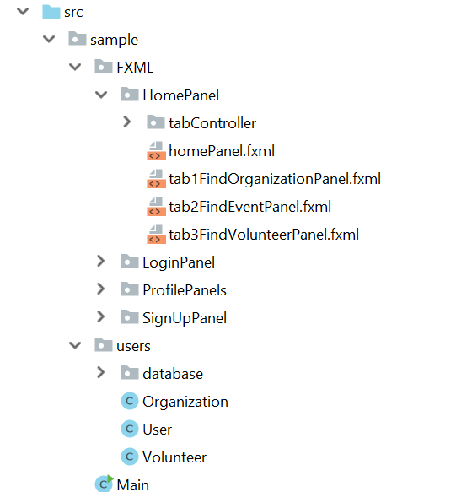
DESIGN PROTOTYPE
1-2 slides with 2-3 screen images of your product prototype

Slide 7
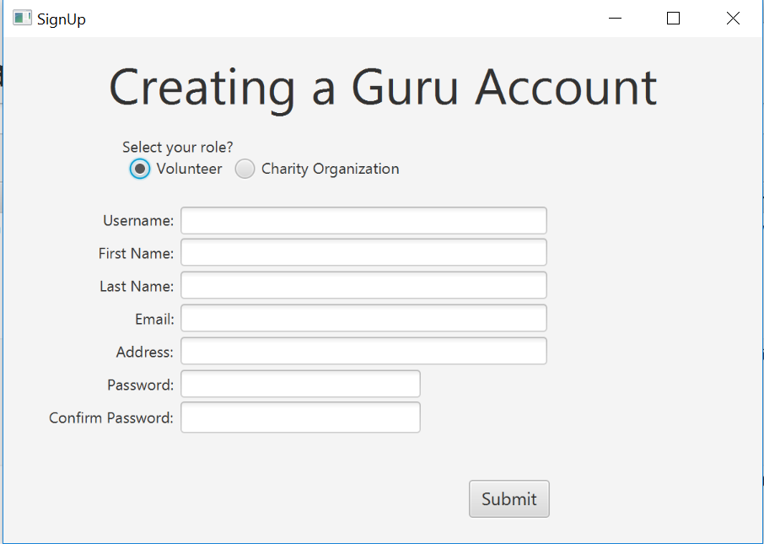
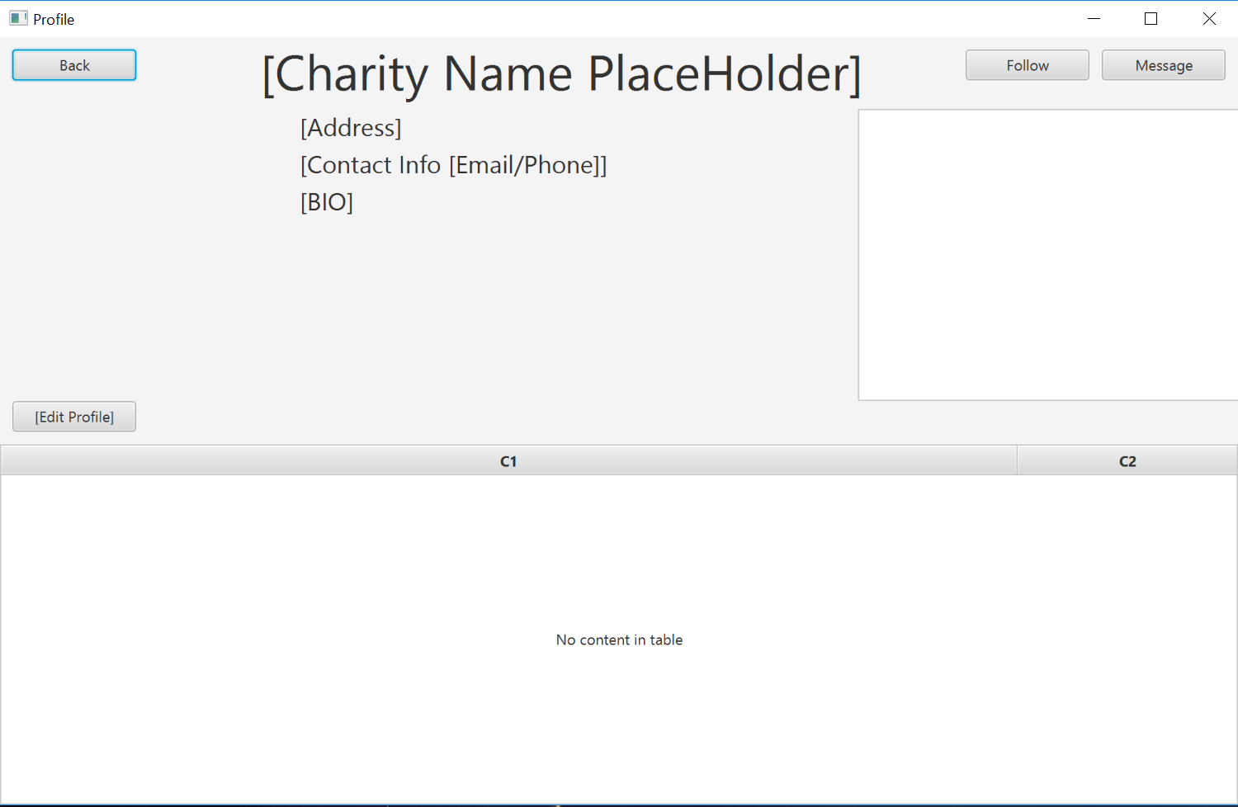
DESIGN PROTOTYPE

Slide 8
VIDEO:
https://www.youtube.com/watch?v=z56H9MeraoA&feature=youtu.be

Slide 9
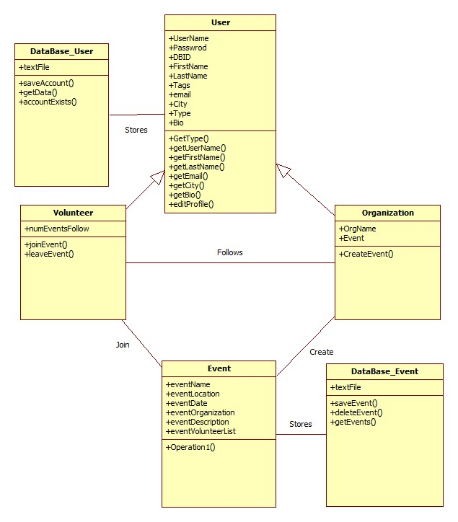
CLASS DIAGRAM

Slide 10
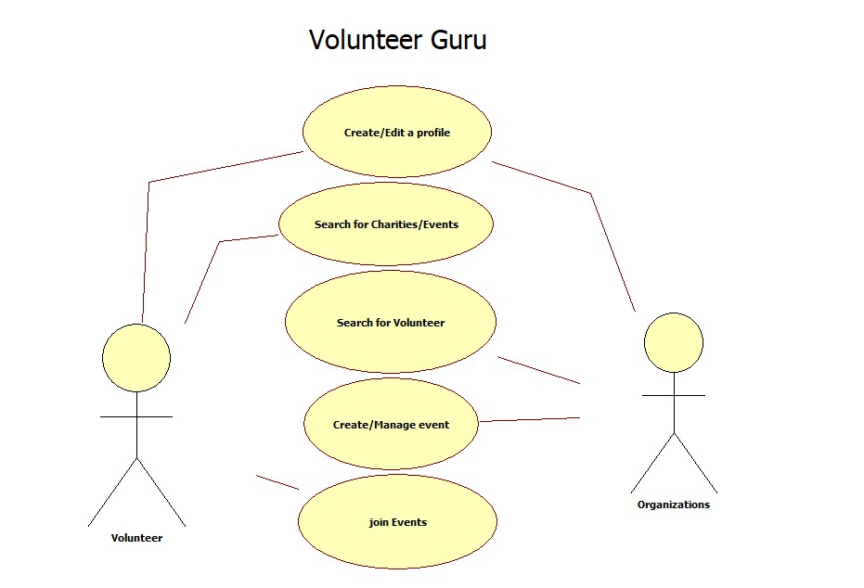
USE-CASE DIAGRAM

Slide 11
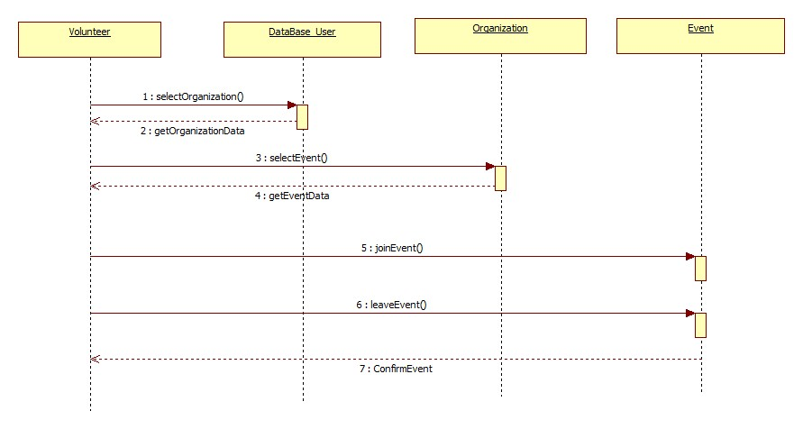
SEQUENCE DIAGRAM

Slide 12
NEXT STEPS
Implement features such as:
Search
Networking (follow button)
Change database structure
Fully complete program design (GUI)
Explore additional content options
Messaging system
Blog posting

Slide 13
The End
Thanks for watching.
Any questions?

